Slide 1
Sales Performance Analysis of Walmart Stores
Video Link : https://www.loom.com/share/850e48a27a924a25bf6d806ddd2b283c?sid=8e871083-fedd-444b-ba90-6881f6e1456f
Nancy Manve

Slide 2
Objective: The main objective of this project is to analyze Walmart’s sales data using advanced MySQL techniques to derive meaningful insights. This includes identifying top-performing stores, understanding customer purchase behavior, and uncovering sales trends based on product categories, regions, and payment methods. The goal is to support data-driven decision-making for improving sales strategies and operational efficiency.

Slide 3
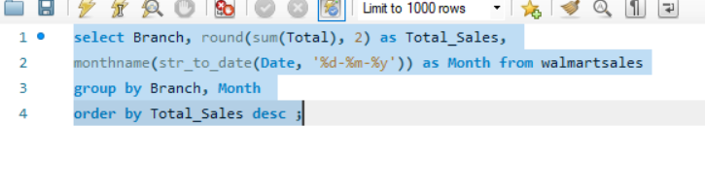
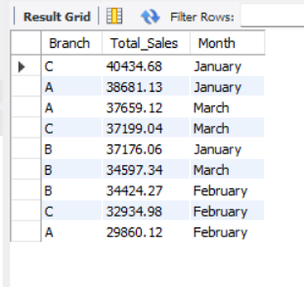
Task 1: Identifying the Top Branch by Sales Growth Rate
Input:
Output:
Insights: Branch C has the highest sales 40343.69 in January Month.

Slide 4
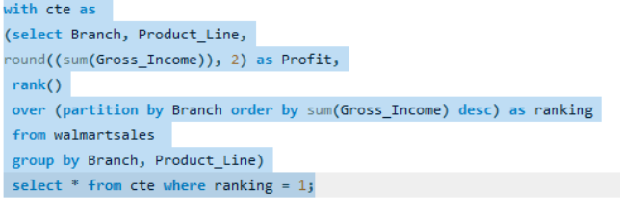
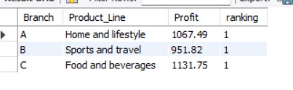
Task 2 : Finding the Most Profitable Product Line for Each Branch
Input:
Output:
Insight:
Branch A earns the most profit from Home and Lifestyle.
Branch B performs best in Sports and Travel.
Branch C profits most from Food and Beverages.

Slide 5
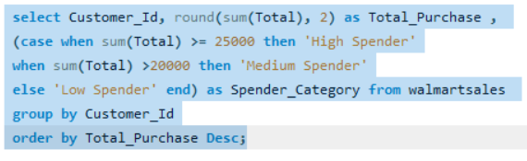
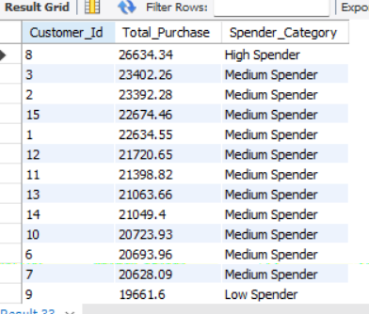
Task 3 : Analyzing Customer Segmentation based on Spending
Input:
Output:
Insights: The person with Customer id 8 spends the highest with total purchase amount of 26634.35 including GST.
Created a column which categories the Customers based on the spending nature, Total Purchase >= 25,000 as High Spender, Total Purchase >=20,000 as Medium Spender else Low Spender

Slide 6
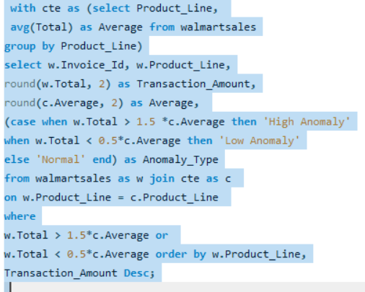
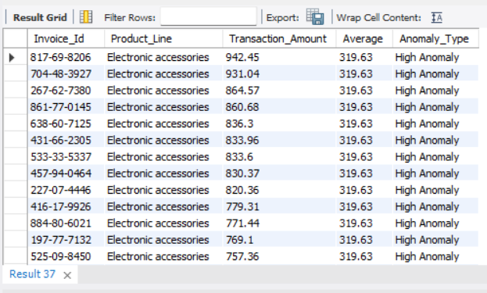
Task 4 : Detecting Anomalies in Sales Transactions
Input:
Output:
High Anomalies represent transactions that are significantly larger than the typical sale for the production line.
Low Anomalies represent small transactions compared to the average.

Slide 7
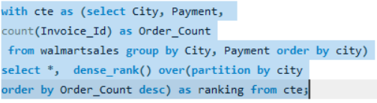
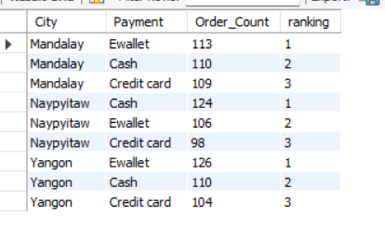
Task 5 : Most Popular Payment Method by City
Input:
Output:
Insights :
Mandalay: Most customers prefer E-wallet as their payment method.
Naypyitaw: cash is the most commonly used payment method.
Yangon: Customers mostly use E-wallet for transaction.

Slide 8
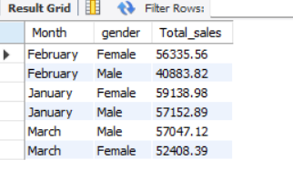
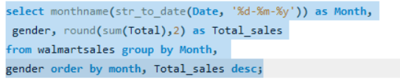
Task 6 : Monthly Sales Distribution by Gender
Input:
Output:
Insight:
January and February: Female customers contributed higher sales than male customers.
March: Male customers total sales exceeded female, showing seasonal buying patterns.
Overall: Sales vary month-to-month and by gender, useful for gender-targeted promotions and marketing campaigns.

Slide 9
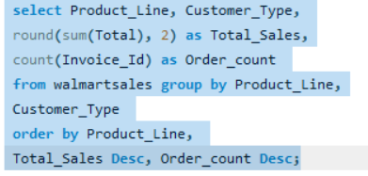
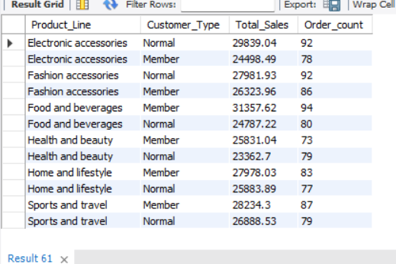
Task 7 : Best Product Line by Customer Type
Input:
Output:
Insights:
Member prefer premium categories like Food and Beverages, Health and Beauty, Home and Lifestyle, Sports and travel.
Normal customers purchase more frequently but spend less per order.
The combination of Total Sales and Order Count provides insight into both revenue generation and purchase frequency.

Slide 10
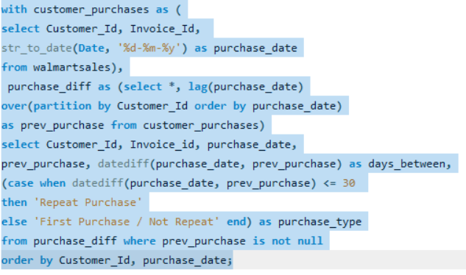
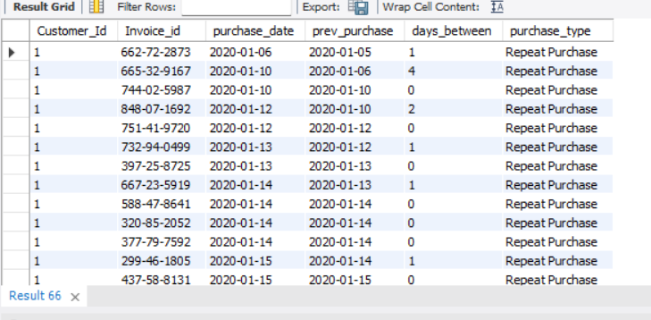
Task 8 : identifying Repeat Customers
Input:
Output:
Insights: Most of the customers are repeat customer, and many of them ordered on same day having different Invoice Id.

Slide 11
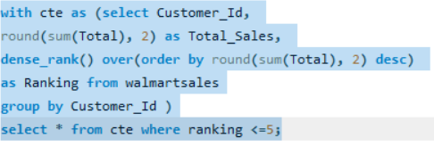
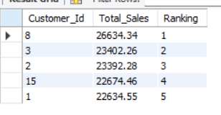
Task 9: Finding Top 5 Customer by Sales Volume
Input:
Output:
Insights: Customer id 8 followed by 3, 2, 15 adn1 are the top 5 customers with high sales value.

Slide 12
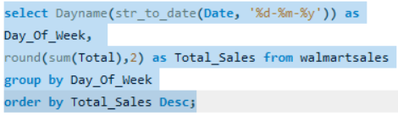
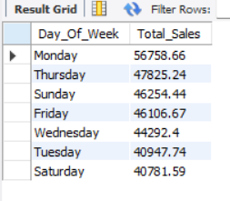
Task 10: Analyzing sales trends by day of the Week
Input:
Insights: Monday has the highest sales followed by Thursday.
Walmart can plan promotions or inventory stock more aggressively on high-sales days.
Output:

Slide 13
Name : Nancy Manve Email : nancymanve100@gmail.com Contact No. : 8103397255
Thank you

